Slide 1
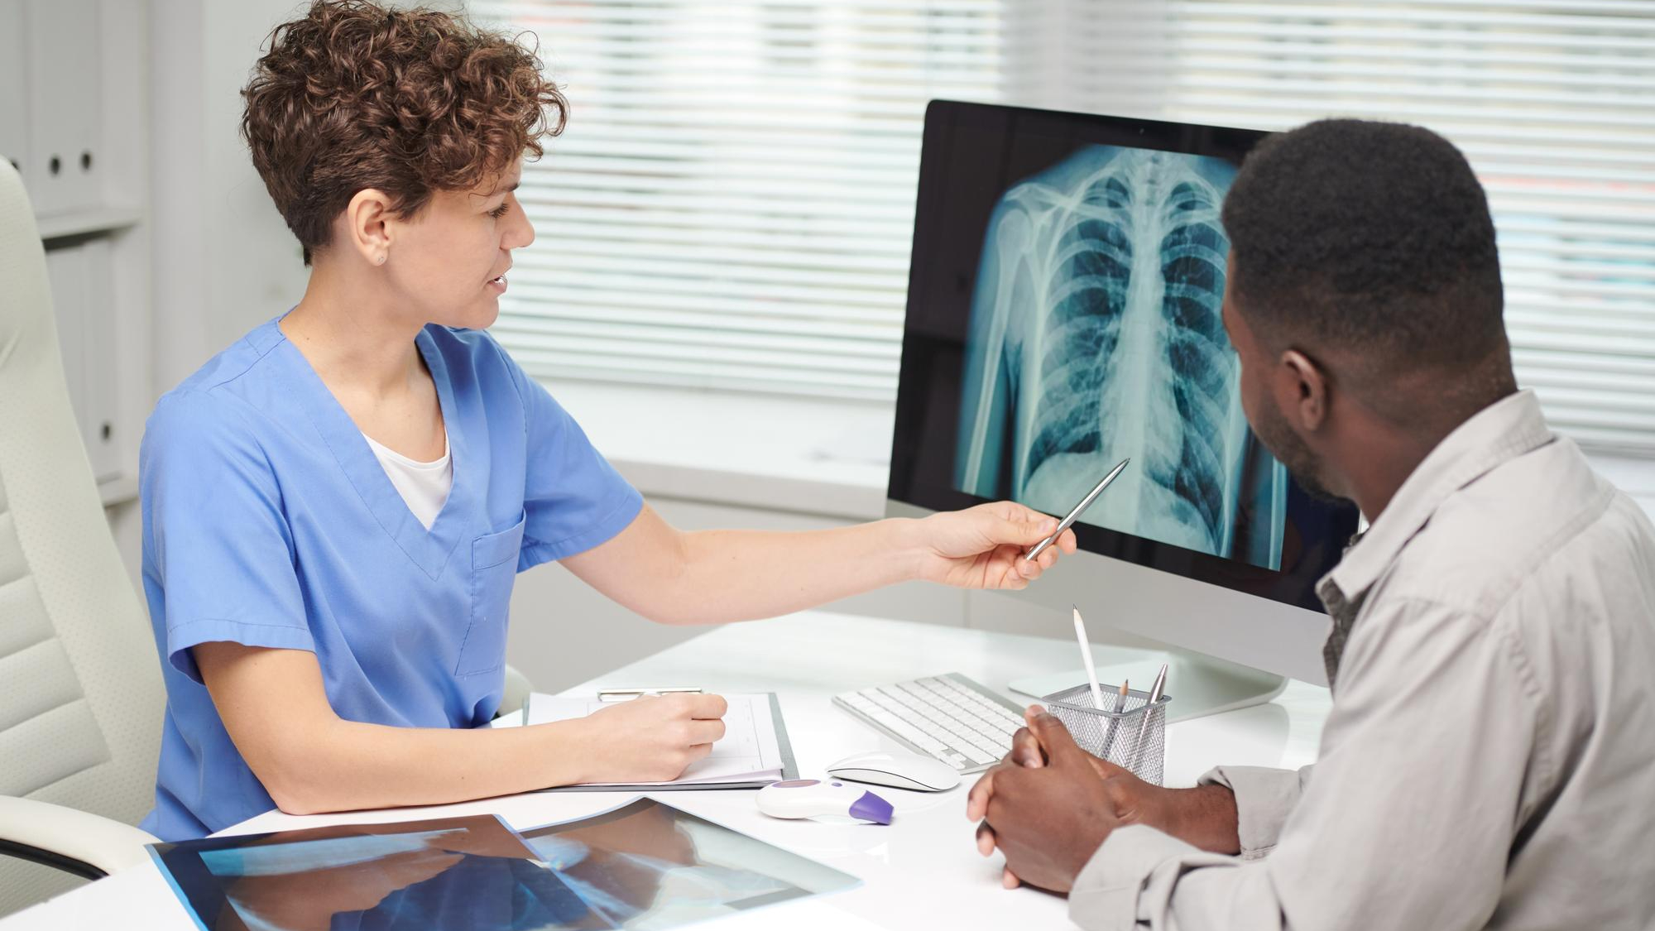
Assessing CNN Robustness in
Medical Imaging Systems:
Adversarial Threats and
Defensive Measures
Group ID : 24-25J-079

Slide 2
Overall Introduction
Medical imaging systems diagnose diseases using machine learning models, aiding in healthcare decisions.
These systems are vulnerable to adversarial attacks that subtly alter input images.
Adversarial attacks can change predictions, causing misdiagnosis and compromising patient safety.
Robust defense strategies are essential to ensure the reliability and security of these systems.

Slide 3
Overall Research Gap
There is a lack of comprehensive evaluation of how adversarial attacks impact CNN-based medical imaging systems.
Existing defense mechanisms have not been thoroughly tested for their effectiveness across diverse attack types and model architectures.
This gap is particularly significant for chest X-ray classification, where robustness is critical for reliable and secure diagnostics.

Slide 4
Overall Objectives
1
Investigate Adversarial Attacks
2
Evaluate Model Robustness
3
Test and Validate Defense Strategies
4
Measure Defense Effectiveness

Slide 5
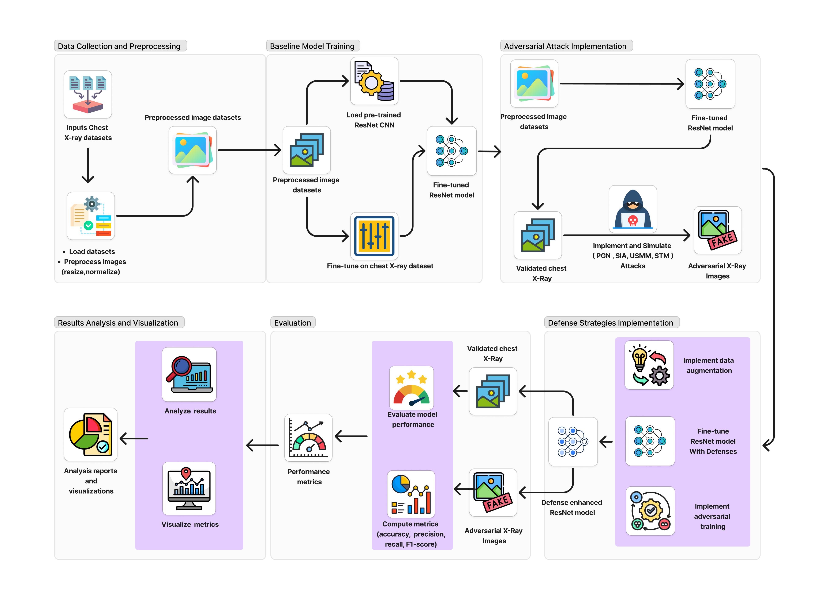
Overall System Diagram

Slide 6
CNN Models

Slide 7
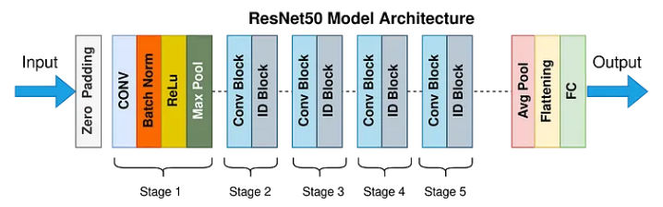

ResNet50
Input: The input layer takes an image with dimensions 224x224 pixels.
Convolutional Layers: These layers apply numerous filters to the input to create feature maps that abstract the input data.
Pooling Layers: Used between convolutional layers, pooling reduces the dimensionality of each feature map but retains the most important information.
Residual Blocks: Each block has convolutional layers with batch normalization and ReLU activation, followed by a skip connection that adds the input of the block to its output.
Output: A global average pooling layer followed by a fully connected layer that maps the features learned by the network into the final output classes.

Slide 8
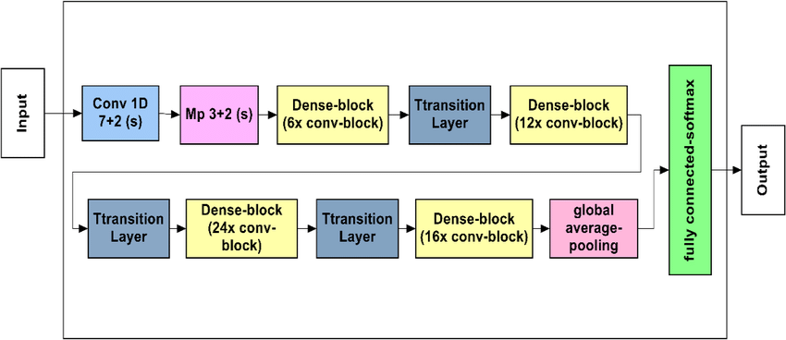
DenseNet121
Input Layer: DenseNet121 takes an input image of size 224x224 pixels.
Dense Blocks and Transition Layers:
Dense Blocks: These blocks contain several convolutional layers, where each layer is connected to every other layer in the block. Each layers consists of batch normalization, a ReLU activation function, and a convolutional layer.
Transition Layers: Positioned between dense blocks, these layers do convolution and pooling.
Global Average Pooling and Output: After the last dense block, a global average pooling layer reduces the spatial dimensions to 1x1.

Slide 9
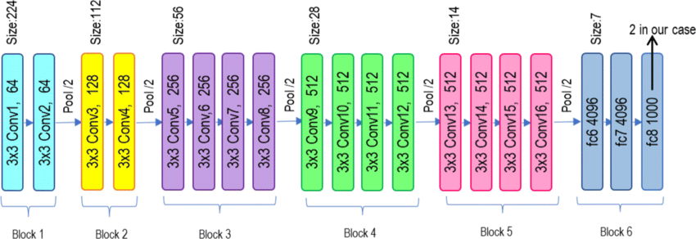
VGGNet19
Input Layer: Accepts images of size 224x224x3.
Convolutional Layers: Contains 16 convolutional layers, all using 3x3 filters with stride 1 and padding to retain spatial dimensions. Each layer is followed by a ReLU activation functio.
Pooling Layers: A 2x2 max-pooling layer with stride 2 is applied after every 2-3 convolutional layers, progressively reducing spatial dimensions while retaining key features.
Fully Connected Layers: Includes three fully connected (FC) layers.
Output Layer: Utilizes a softmax activation function to produce probabilities for each class.

Slide 10
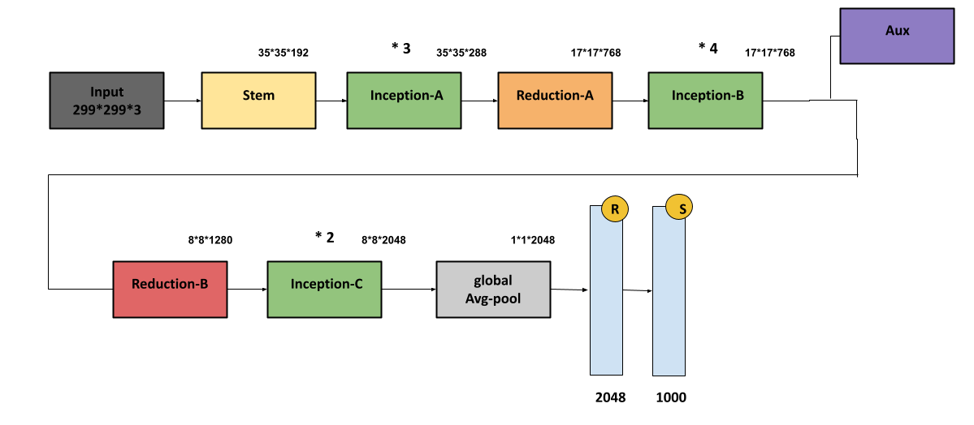
InceptionV3
Input Layer: Accepts images of size 299x299x3.
Convolutional Layers: Initial layers perform feature extraction using traditional convolutions and max pooling.
Inception Modules: Stacks multiple Inception modules, each combining filters of different sizes and pooling layers.
Auxiliary Classifiers: Two auxiliary classifiers are added before the final output, acting as regularizers.
Output Layer: A softmax classifier provides probabilities for each class

Slide 11
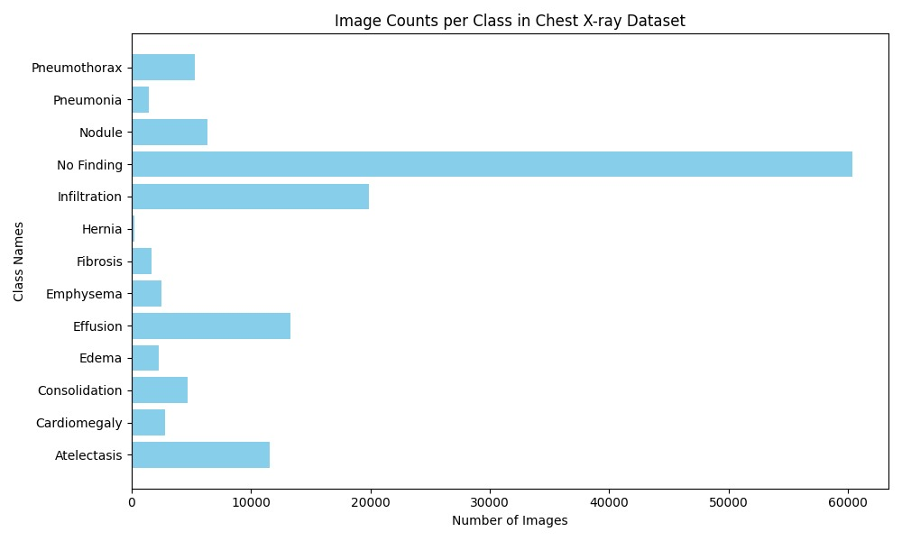
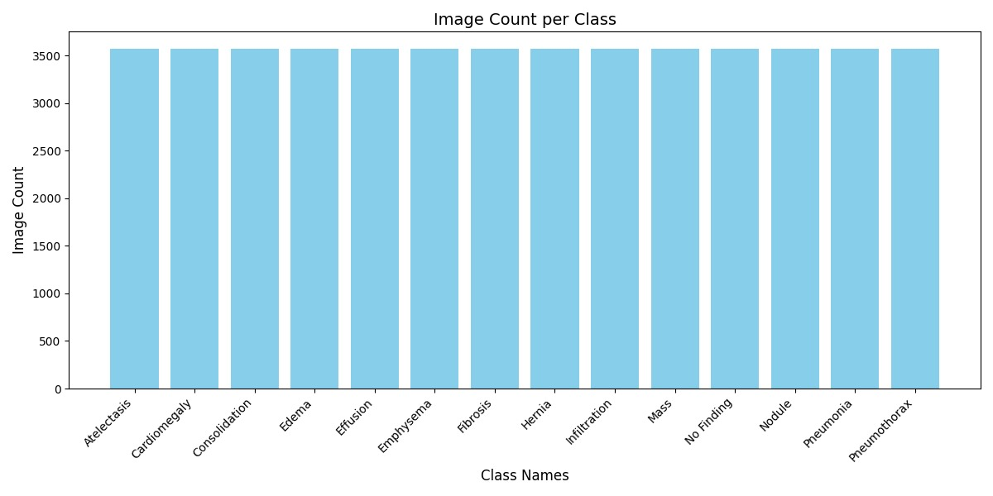
Dataset
Dataset Selection: Chest X-ray
Number of images: 112,120 X-ray images
Number of Classes: 14
Normalization: Data Augmentation
Before Data Augmentation
After Data Augmentation

Slide 12

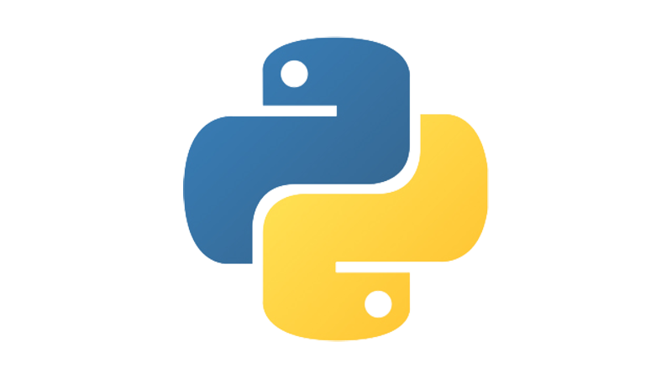





Tools and Technologies
DL Frameworks
Model Architectures
TensorFlow
ResNet50
DenseNet121
VGG19
Inception V3
Programming Lang.
Data Management Tools
Visualization Tools
Python
Pandas
NumPy
Matplotlib
Evaluation Metrics
IDE & Compute Resources
Scikit-learn
Google Colab

Slide 13

IT21197550
Nihila Premakanthan
Cyber Security

Slide 14
Robustness Evaluation of CNN Against Style Transfer Manipulation (STM) Adversarial Attack
1
Introduction
2
Research Problem
3
Objectives
4
Literature Review
5
Methodology
5
Current Progress

Slide 15
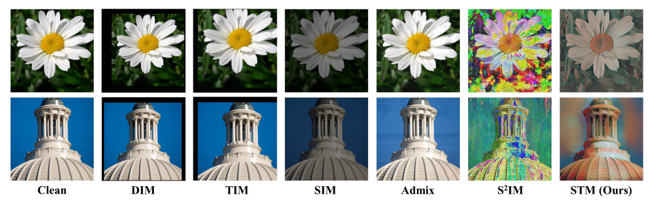
Introduction
What is STM Attack?
STM (Style Transfer Manipulation) attack is a type of adversarial attack where the style image is added to the original image in order to create the adversarial image.

Slide 16
Research Gap
Lack of comprehensive evaluation of how Style Transfer Manipulation attacks impact CNN-based medical imaging systems.
Existing defense mechanisms have not been thoroughly tested for their effectiveness Style Transfer Manipulation attacks and model architectures.

Slide 17

Research Problem
How effective are existing defense strategies in enhancing the robustness of CNN models used for chest X-ray classification against STM attacks?
How can these defense strategies be tested and validated to ensure reliable and secure medical diagnostics?

Slide 18
Objectives
1
Fine-Tune CNN
2
Implement STM Attack
3
Evaluate Performance Metrics
4
Test Defence Strategies
5
Validate Defence Effectiveness

Slide 19
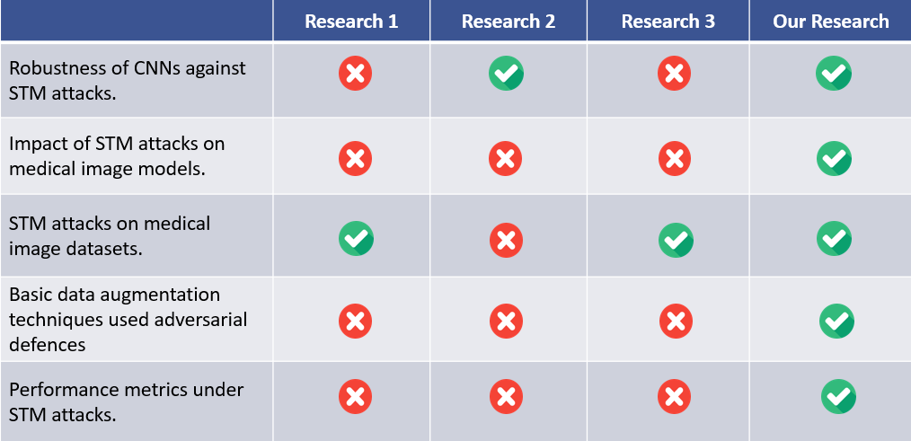
Literature Review

Slide 20
Methodology
System Diagram
1
2
Technologies
3
4
Defense Strategies
Attack Method

Slide 21
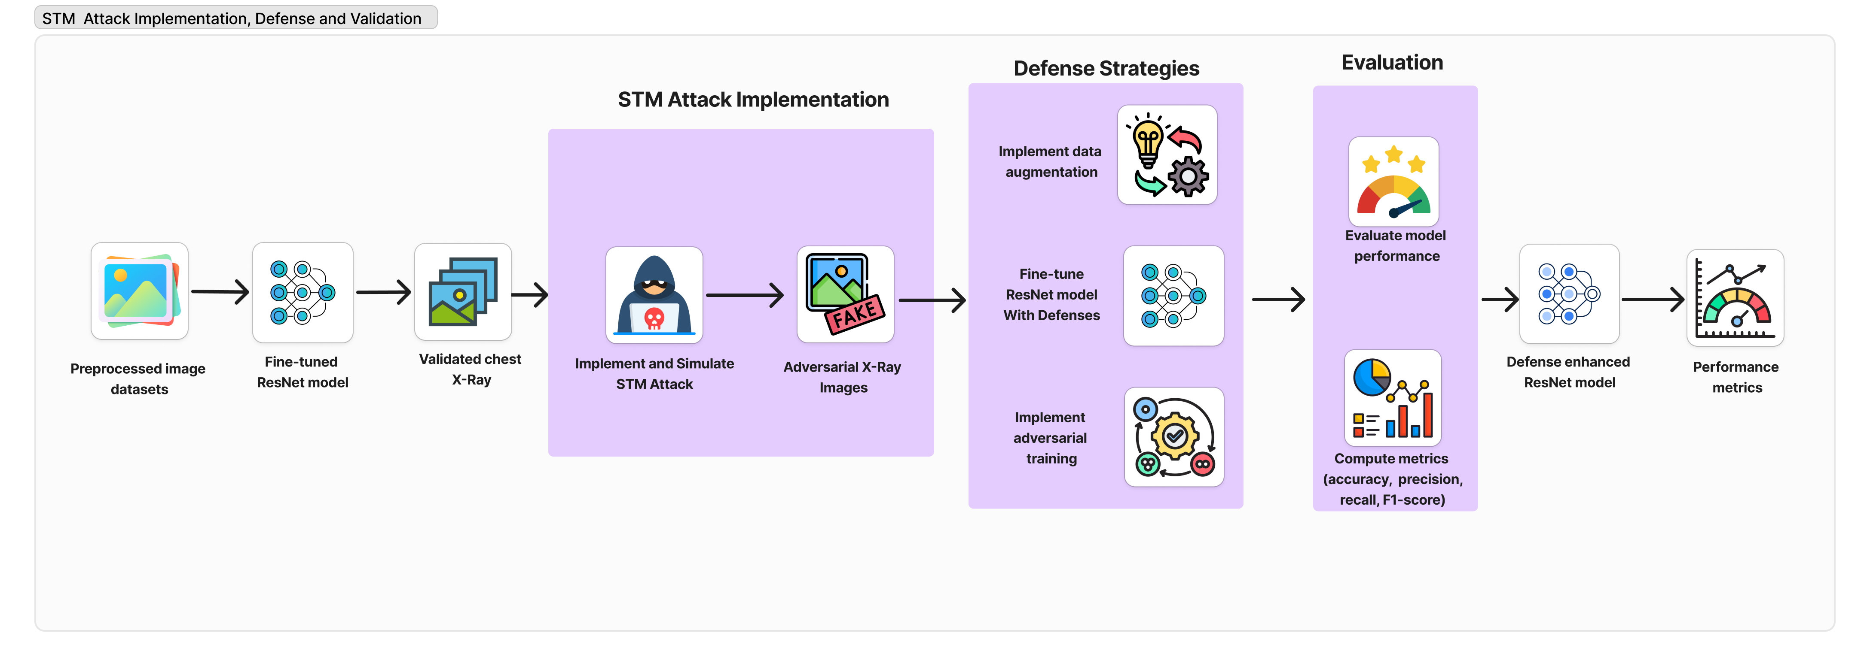
System Diagram

Slide 22
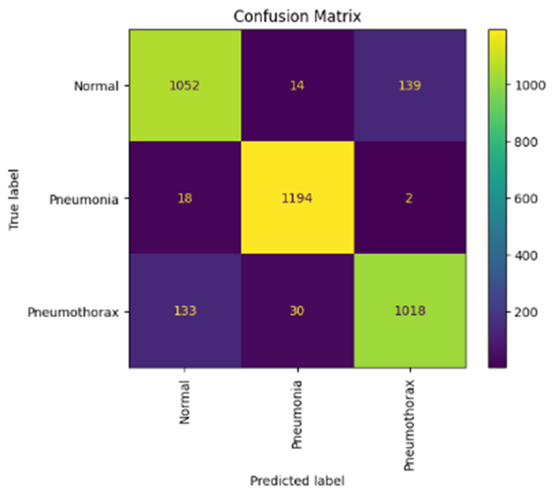
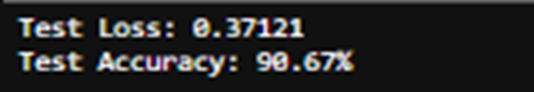

Resnet50 Model before attack implementation

Slide 23
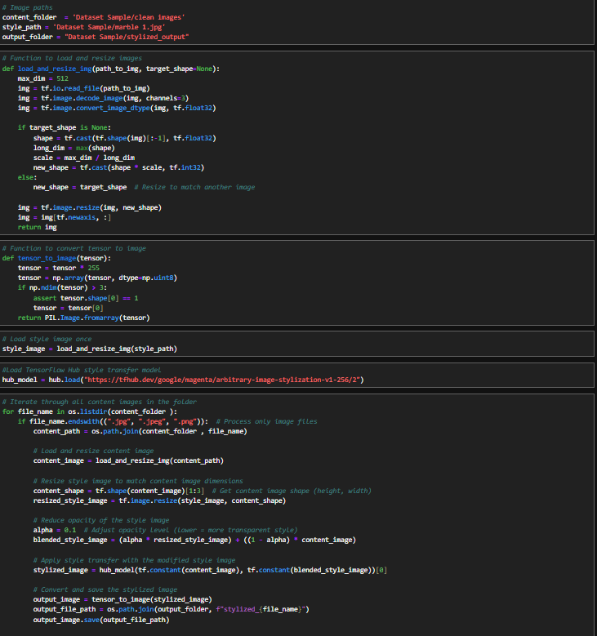
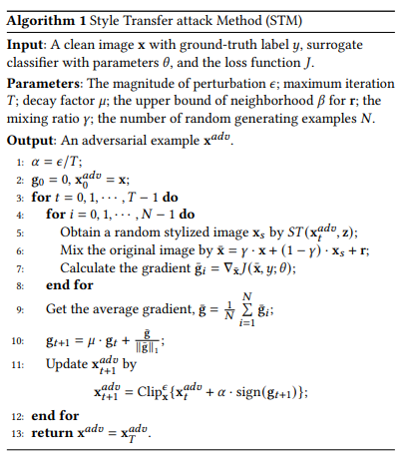
Attack Method – STM
2
3
7
6
8
9
10

Slide 24
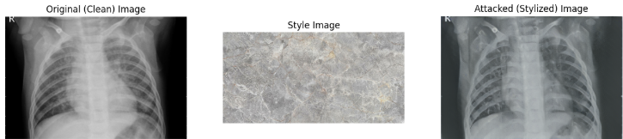
Attack Method – STM

Slide 25
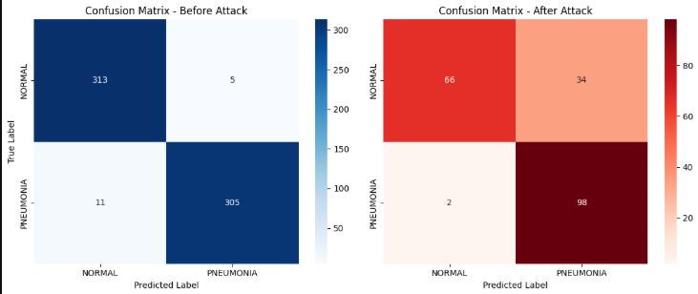
Attack Method – STM

Slide 26
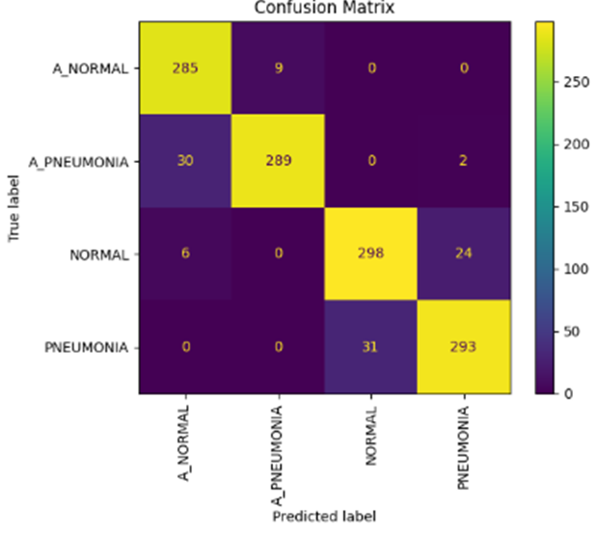
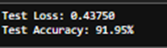
Defense Mechanism – STM
Adversarial Training (AT)

Slide 27
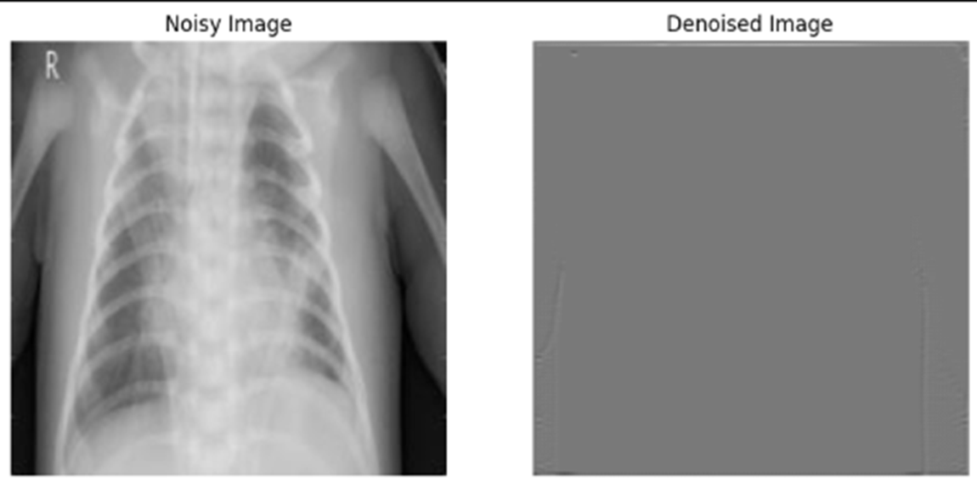
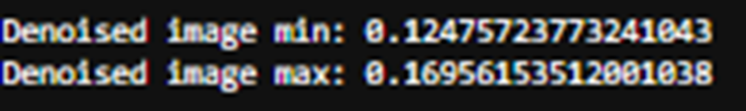
High Level Representation Guided Denoiser(HGD)

Slide 28
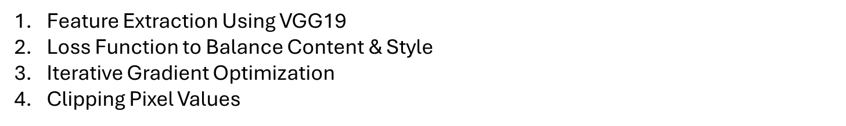
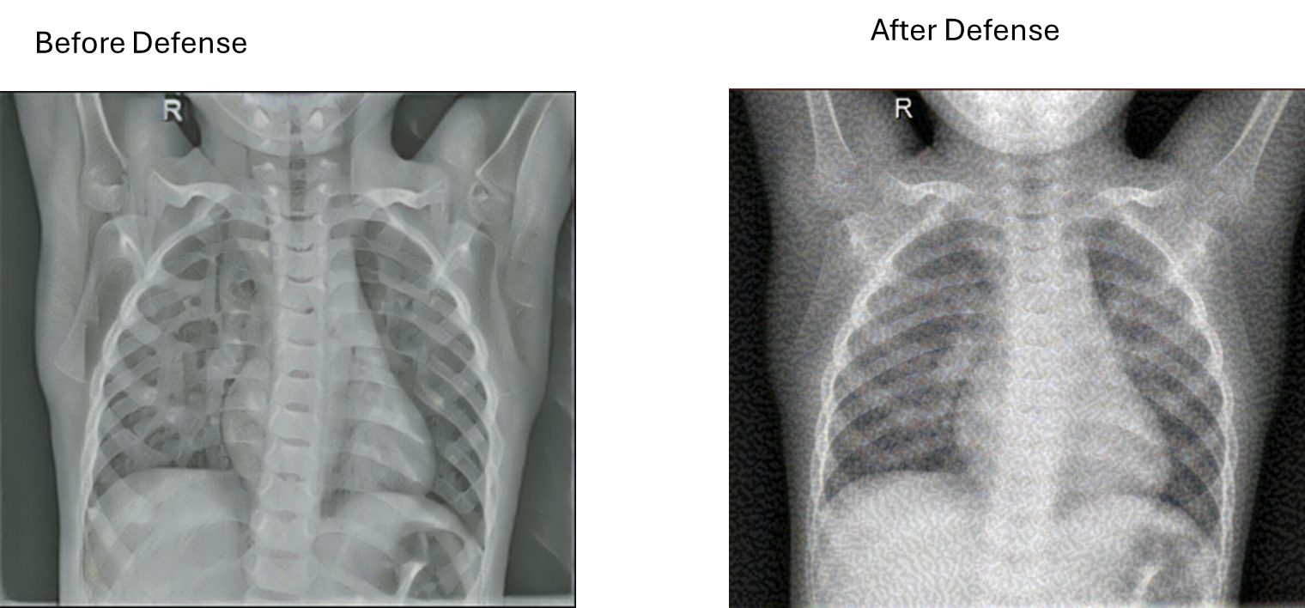
Feature Consistency Defense

Slide 29
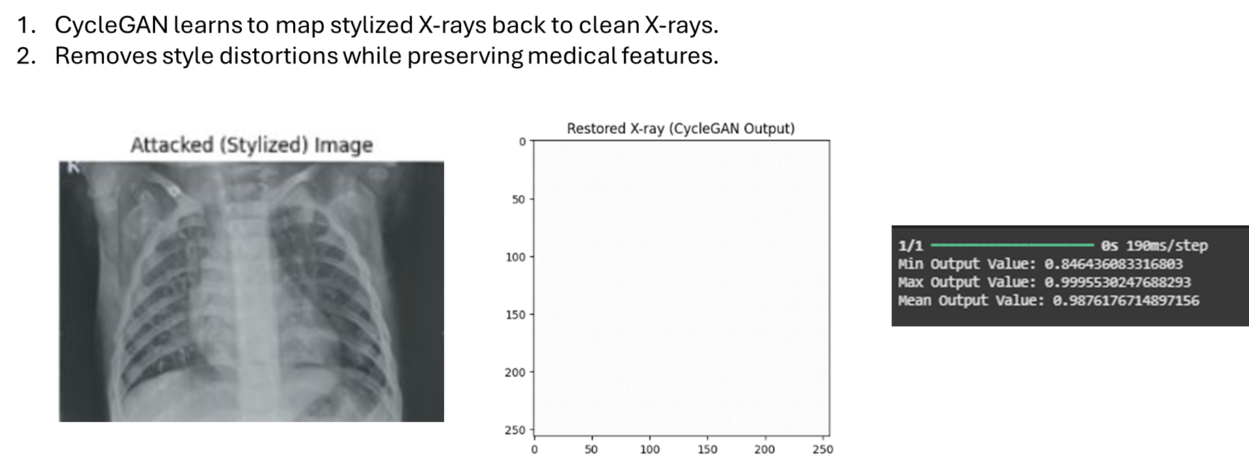
CycleGAN Model Based Defense

Slide 30
Current Progress
1
Data Preprocessing
Image Preprocessing: Resized all images to the input size required by the model (e.g., 224x224 for ResNet50)
Data Augmentation: Applied various augmentation techniques to improve model generalization
2
2
Model Setup
Model Setup
Trained Resnet50 (pretrained on ImageNet) to leverage powerful feature extraction capabilities.
Trained Resnet50 (pretrained on ImageNet) to leverage powerful feature extraction capabilities.
3
Attack Simulation
Simulated STM attack on CNN and shown misclassification after the attack.
4
Assessing Defense Mechanism
Assessed different defense mechanisms against the attack

Slide 31
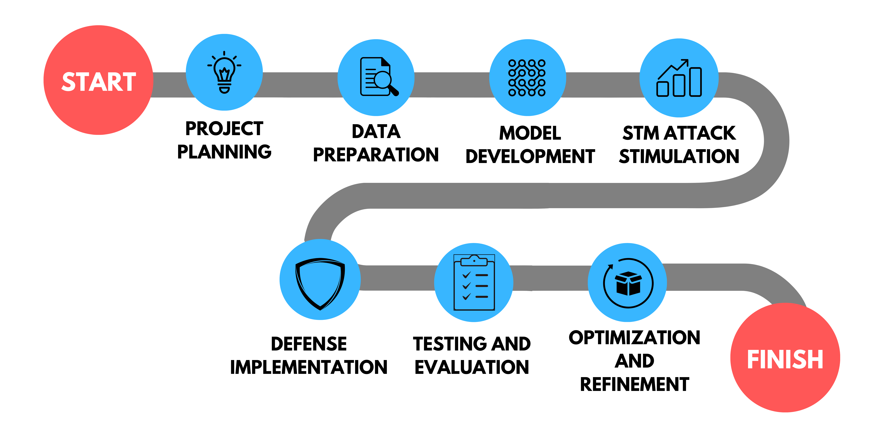

Project Completion

Slide 32
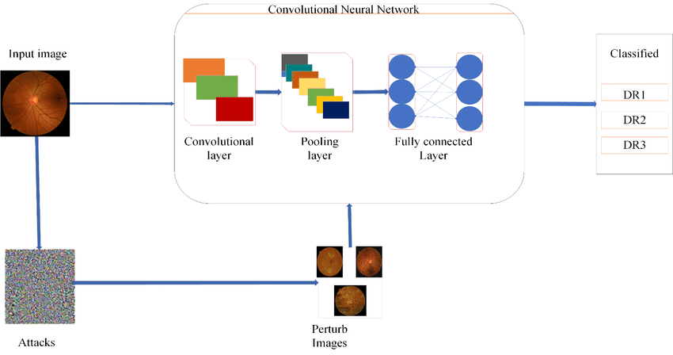
Defence Strategies
Adversarial Training (AT)
Histogram Gradient Descent (HGD)
Randomized Smoothing (RS)
Randomized Noise Reduction and
Preprocessing (NRP)

Slide 33
References
[1] Zhilu Zhang, Xi Yang, and Kaizhu Huang, "Attacking Sequential Learning Models with Style Transfer Based Adversarial Examples," Journal of Physics: Conference Series, vol. 1880, 2021. doi: 10.1088/1742-6596/1880/1/012021.
[2] Qiuling Xu, Guanhong Tao, Siyuan Cheng, and Xiangyu Zhang, "Towards Feature Space Adversarial Attack by Style Perturbation," in Proceedings of the AAAI Conference on Artificial Intelligence, vol. 35, no. 10, pp. 10523-10530, May 2021. Available: https://arxiv.org/abs/2004.12385.
[3] Zhilu Zhang, Xi Yang, and Kaizhu Huang, "Improving the Transferability of Adversarial Examples with Arbitrary Style Transfer," Journal of Physics: Conference Series, vol. 1880, 2021. Available: https://iopscience.iop.org/article/10.1088/1742-6596/1880/1/012021.

Slide 34

IT21155802
D.S.C. Wijesuriya
Cyber Security

Slide 35
Assessing CNN Resilience to Penalizing Gradient Norm (PGN) Adversarial Attack
1
Introduction
2
Research Problem
3
Objectives
4
Literature Review
5
Methodology
5
Current Progress

Slide 36
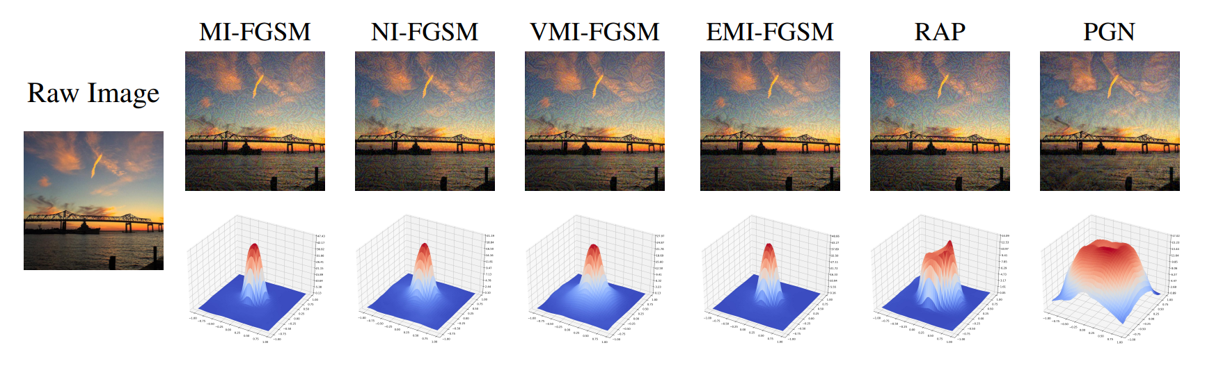
Introduction
What is PGN Attack?
The Penalizing Gradient Norm (PGN) attack is a type of adversarial attack that increases the sensitivity of neural network models to small perturbations in the input data.

Slide 37
Research Gap
Lack of comprehensive evaluation of how Penalizing Gradient Norm (PGN) Attacks impact CNN-based medical imaging systems.
Existing defense mechanisms have not been thoroughly tested for their effectiveness Penalizing Gradient Norm (PGN) attacks and model architectures with medical imaging.

Slide 38

Research Problem
How effective are existing defense strategies in enhancing the robustness of CNN model used for chest X-ray classification PGN adversarial attacks?
How can these defense strategies be tested and validated to ensure reliable and secure medical diagnostics?

Slide 39
Objectives
1
Fine-Tune CNN
2
Implement PGN Attack
Fine-tune the CNN models to evaluate their performance under PGN attack conditions.
Develop and apply the Penalizing Gradient Norm (PGN) attack on chest X-ray datasets using CNN model.
3
Evaluate Performance Metrics
4
Test Defence Strategies
Assess the impact of PGN attacks on model performance using metrics such as accuracy, precision, recall, and F1-score.
Test existing defense strategies, such as data augmentation and adversarial training, to mitigate the effects of PGN attacks on CNN models.
5
Validate Defence Effectiveness
Validate the effectiveness of the defense strategies by comparing model performance on clean and adversarial datasets.

Slide 40
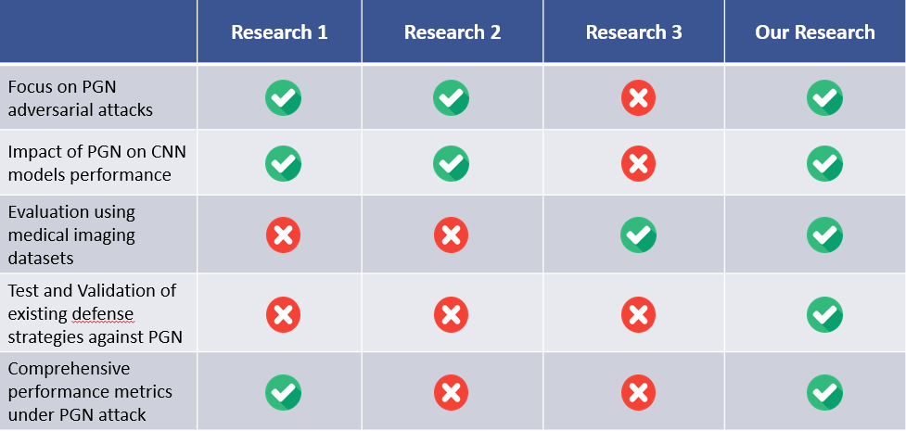
Literature Review

Slide 41
Methodology
System Diagram
1
2
Technologies
3
4
Defense Strategies
Attack Method

Slide 42
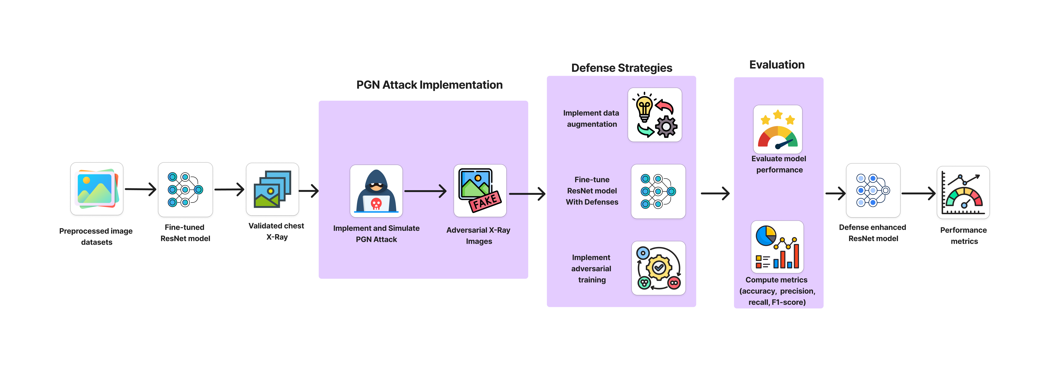
System Diagram

Slide 43
Tools and Technologies
DL Frameworks
Model Architectures
TensorFlow
ResNet50
DenseNet121
VGG19
Inception V3
Programming Lang.
Data Management Tools
Visualization Tools
Python
Pandas
NumPy
Matplotlib
Evaluation Metrics
IDE & Compute Resources
Scikit-learn
Google Colab

Slide 44
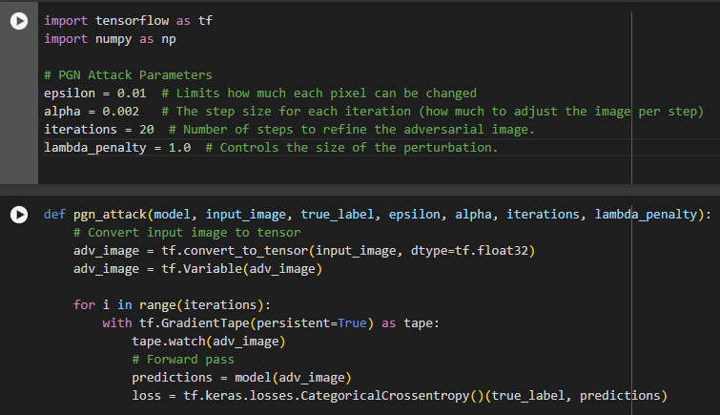
Attack Method – PGN
Model
Input Image
True Label
Epsilon: Maximum Perturbation
Alpha: Step Size
Iterations: Number of Iterations
Lambda Penalty: Gradient penalty coefficient
Dr.Bakron

Slide 45
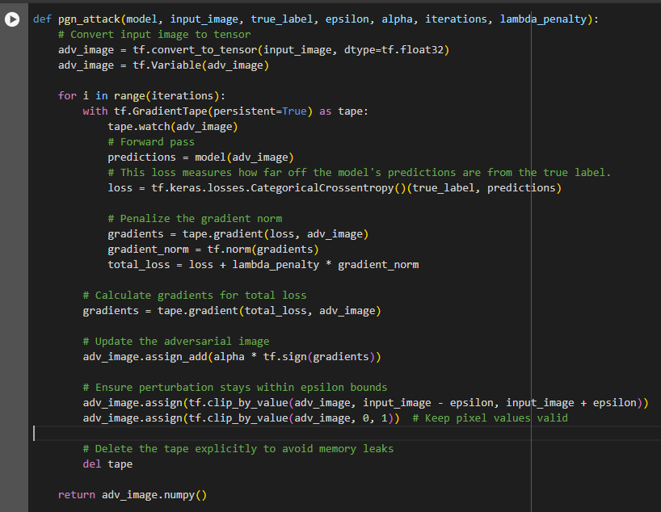
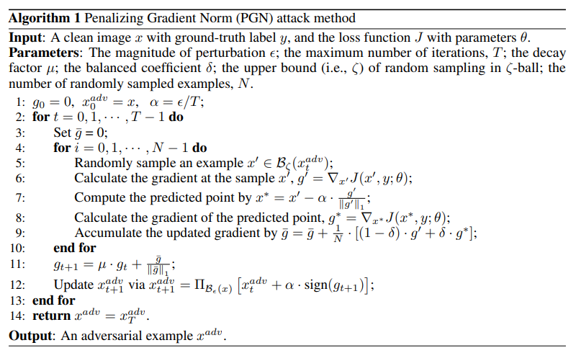
1
2
3
4
5
Dr.Bakron
6

Slide 46
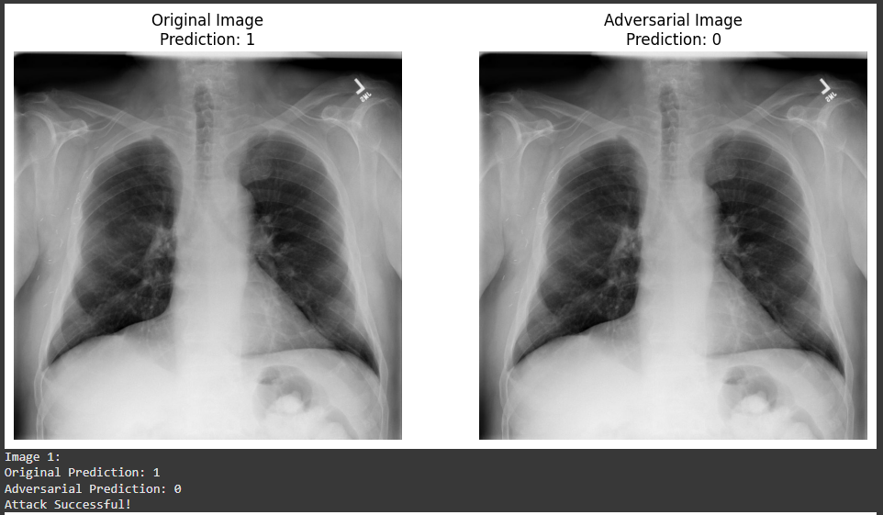
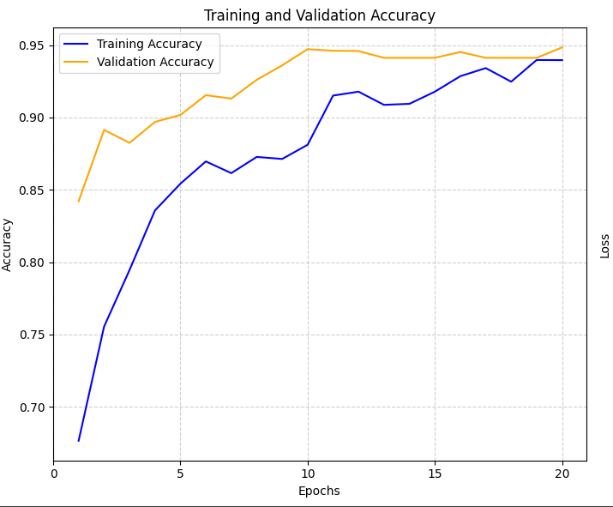
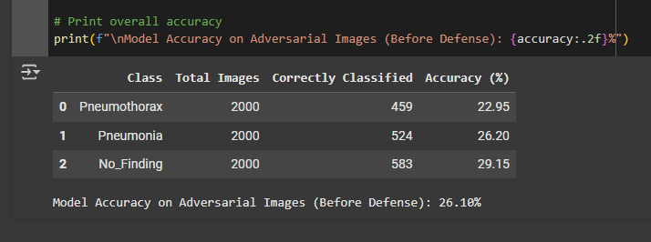
Dr.Bakron

Slide 47
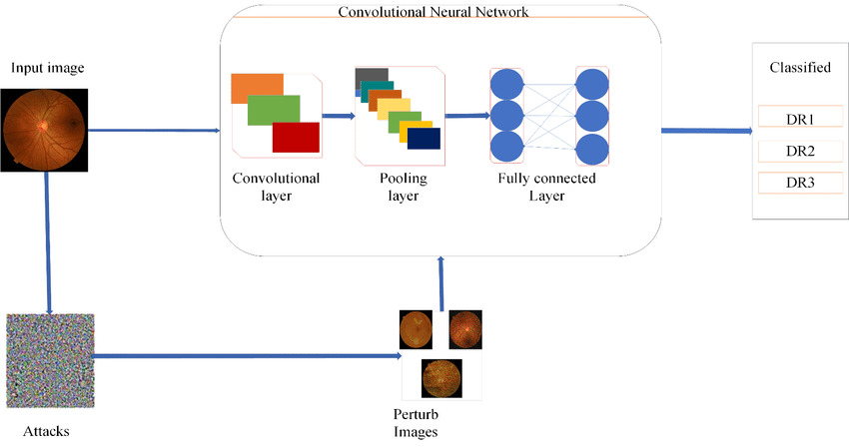
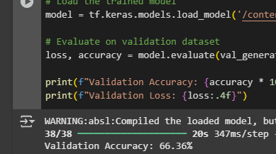
Defence Strategy
Adversarial Training (AT)

Slide 48
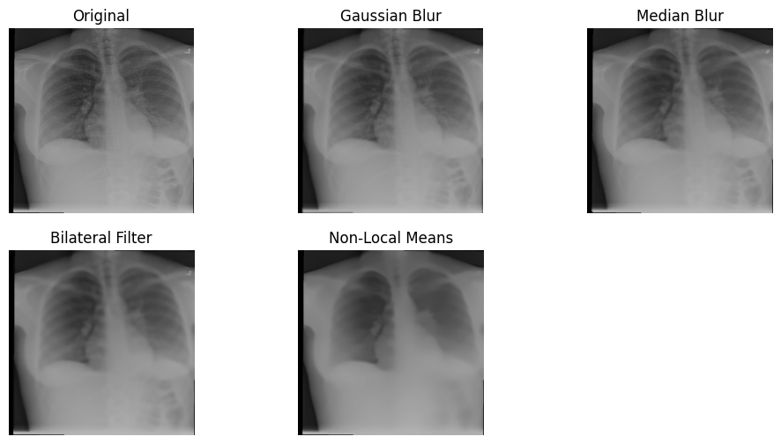
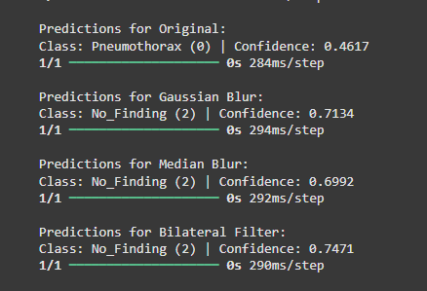
Defence Strategy
Different Denoising Technique

Slide 49
Current Progress
1
Data Preprocessing
Image Preprocessing: Resized all images to the input size required by the model (e.g., 299x299 for Inception V3)
Data Augmentation: Applied various augmentation techniques to improve model generalization
2
2
Model Setup
Model Setup
Trained Inception V3 (pretrained on ImageNet) to leverage powerful feature extraction capabilities.
Trained Resnet50 (pretrained on ImageNet) to leverage powerful feature extraction capabilities.
3
Attack Simulation
Simulated PGN attack on CNN and shown misclassification after the attack.
4
Defense Implementation
Implemented Adversarial Training, Denoising Technique and Evaluated

Slide 50

Project Completion

Slide 51
References
[1] Z. Ge, H. Liu, X. Wang, F. Shang, and Y. Liu, "Boosting Adversarial Transferability by Achieving Flat Local Maxima," Neural Information Processing Systems (NeurIPS 2023), arXiv:2306.05225, Nov. 2023. [Online]. Available: https://arxiv.org/abs/2306.05225
[2] Li, Xiangjuan & Li, Feifan & Li, Yang & Pan, Quan. (2023). PGN: A Perturbation Generation Network Against Deep Reinforcement Learning. 611-618. 10.1109/ICTAI59109.2023.00096.
[3] J. Dong, J. Chen, X. Xie, J. Lai, and H. Chen, "Adversarial Attack and Defense for Medical Image Analysis: Methods and Applications," arXiv, arXiv:2303.14133, Mar. 2023. [Online]. Available: https://doi.org/10.48550/arXiv.2303.14133

Slide 52

IT21166860
P.G.E.J. Sandamal
Cyber Security

Slide 53
Robustness Evaluation of CNN Against Structure Invariant Attack (SIA) Adversarial Attack
1
Introduction
2
Research Problem
3
Objectives
4
Literature Review
5
Methodology
6
Current Progress

Slide 54
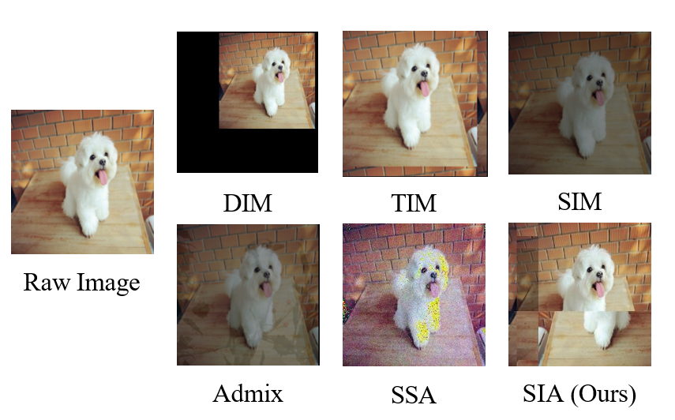
Introduction
What is SIA Attack?
The Structure Invariant Attack (SIA) attack divides an image into blocks and applies transformations to deceive CNNs, causing misclassification. It exploits CNNs' spatial consistency, posing threats to AI systems, especially in medical imaging.

Slide 55

Research Problem
How effective are existing defence strategies in enhancing the robustness of CNN models used for chest X-ray classification against SIA attacks?
How can these defence strategies be tested and validated to ensure reliable and secure medical diagnostics?

Slide 56
Research Gap
Lack of comprehensive evaluation of how Structure Invariant Attack (SIA) impact CNN-based medical imaging systems.
Existing defense mechanisms have not been thoroughly tested for their effectiveness Structure Invariant Attack (SIA) and model architectures.
Currently not verify this attack on Medical Images

Slide 57
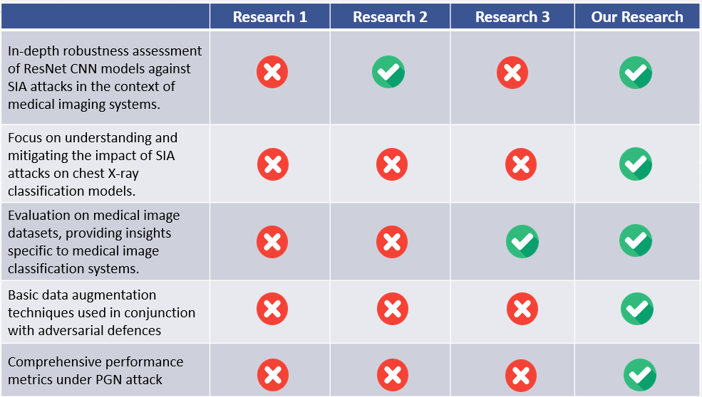
Literature Review

Slide 58
Objectives
1
Fine-Tune CNN
2
Implement SIA Attack
Fine-tune the CNN models to evaluate their performance under SIA attack conditions.
Develop and apply the SIA attack on chest X-ray datasets using CNN model.
3
Evaluate Performance Metrics
4
Test Defence Strategies
Assess the impact of SIA attacks on model performance using metrics such as accuracy, precision, recall, and F1-score.
Test existing defense strategies, such as data augmentation and adversarial training, to mitigate the effects of SIA attacks on CNN models.
5
Validate Defence Effectiveness
Validate the effectiveness of the defense strategies by comparing model performance on clean and adversarial datasets.

Slide 59
Methodology
System Diagram
1
2
Technologies
3
4
Defense Strategies
Attack Method

Slide 60

System Diagram

Slide 61
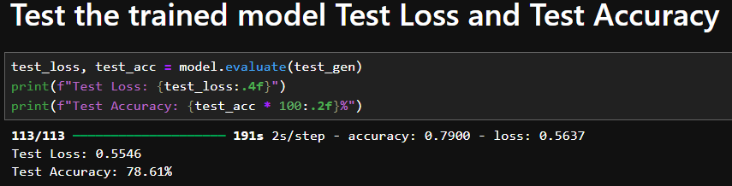
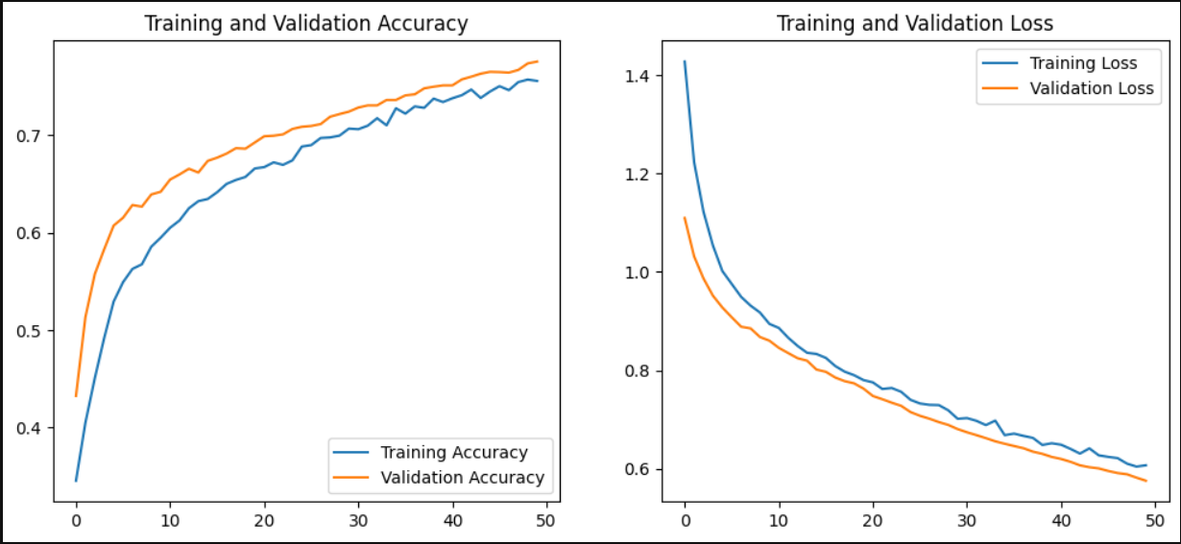
DenseNet121 Model Training
Dr.Bakron

Slide 62
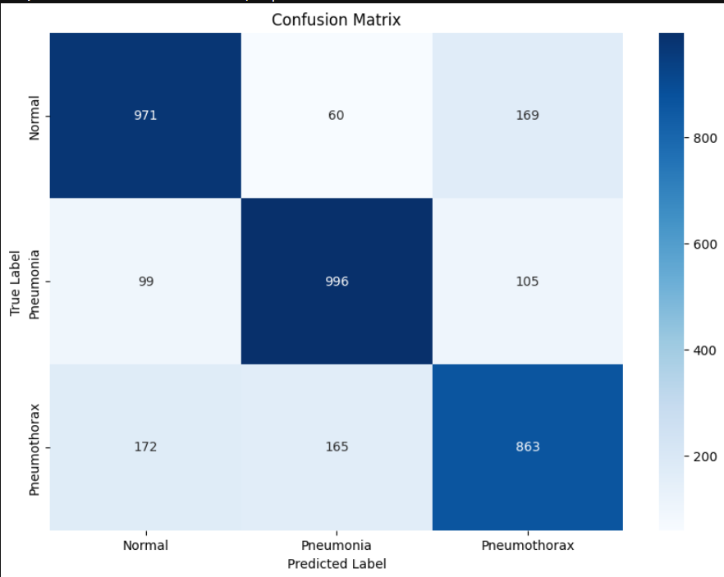
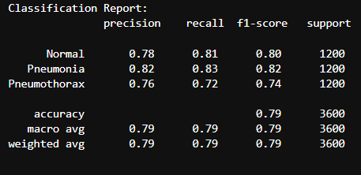
Confusion Matrix after the Model Training
Dr.Bakron

Slide 63
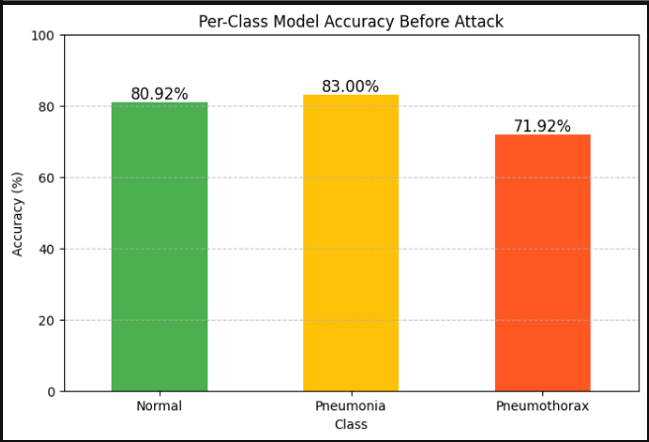
Class Per Accuracy after the Model training
Dr.Bakron

Slide 64
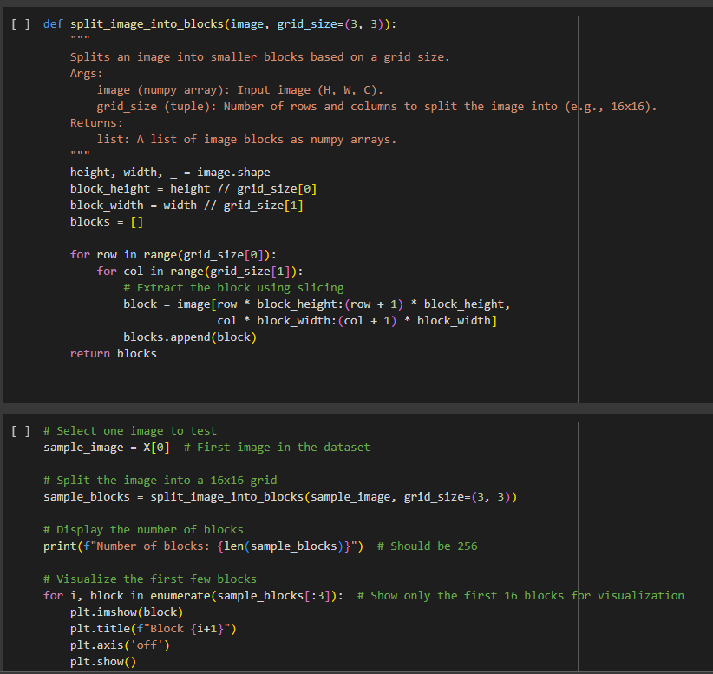
Attack Method – SIA
Color: Minimal changes to avoid altering the global appearance.
Texture: Limited adjustments to ensure surface consistency with the original input.
Perceptual Features: Modifications are made at a feature level to fool the model while preserving structure.
High-Level Features: Manipulates feature space representations without affecting the recognizable structure.
Perturbation Smoothness: Ensures perturbations are evenly distributed across the image to avoid noticeable artifacts.
Dr.Bakron

Slide 65
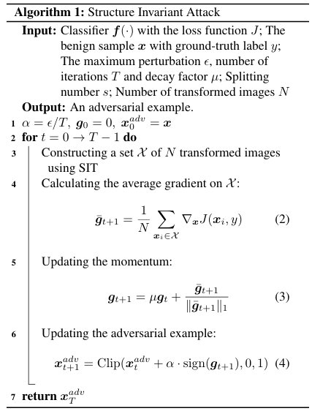
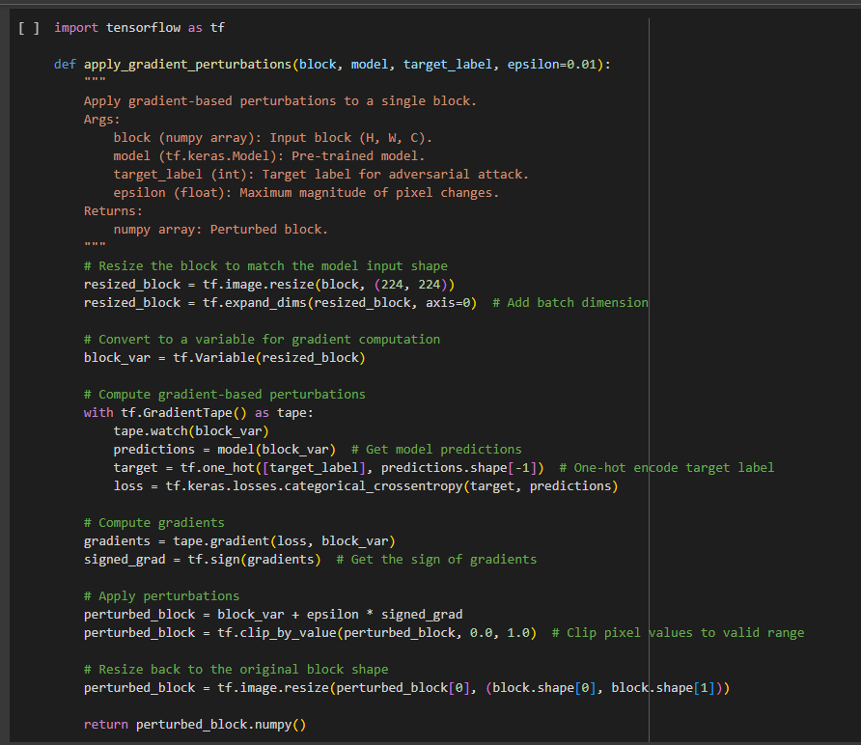
Attack Method – SIA
Dr.Bakron

Slide 66



SIA Attack Deployed Images
Dr.Bakron

Slide 67


Confusion Matrix After the Attack
Dr.Bakron

Slide 68

Class Wise Accuracy Drop down after the Attack
Dr.Bakron

Slide 69
Defence Strategies
Compress the Pixel values
Total Variation Minimization
Adversarial Training (AT)

Slide 70



Defenses for SIA Attack
Dr.Bakron

Slide 71

Class Per Model Accuracy after the Defenses Applied
Dr.Bakron

Slide 72

Sample Image of Defenses Applied
Dr.Bakron

Slide 73



SIA Attack - Detection
Dr.Bakron

Slide 74

SIA Attacked Image Detection
Dr.Bakron

Slide 75

SIA Attacked Detection Rate
Dr.Bakron

Slide 76
Current Progress
Data Preprocessing
Image Preprocessing: Resized all images to the input size required by the model (e.g., 244x244 for DenseNet121)
Data Augmentation: Applied various augmentation techniques to improve model generalization
Model Setup
Trained DenseNet121 (pretrained on ImageNet) to leverage powerful feature extraction capabilities.
Attack Simulation
Simulated SIA attack on CNN and shown misclassification after the attack.
Defense Implementation
After the attack deploy on the image, using defined defences can restore the initial stage of the image
Detection Implementation
If the SIA attack deployed on Xray images it can detect using developed detection Algorithm
2

Slide 77

Project Completion

Slide 78
References
[1] I. J. Goodfellow, J. Shlens, and C. Szegedy, "Explaining and harnessing adversarial examples," in Proc. Int. Conf. Learn. Representations (ICLR), San Diego, CA, USA, May 2015, pp. 1-11. [Online]. Available: https://arxiv.org/abs/1412.6572
[2] X. Yuan, P. He, Q. Zhu, and X. Li, "Adversarial examples: Attacks and defenses for deep learning," IEEE Trans. Neural Netw. Learn. Syst., vol. 30, no. 9, pp. 2805-2824, Sep. 2019. [Online]. Available: https://ieeexplore.ieee.org/document/8601309
[3] N. Papernot, P. McDaniel, I. J. Goodfellow, S. Jha, Z. B. Celik, and A. Swami, "Practical black-box attacks against machine learning," in Proc. 2017 ACM Asia Conf. Comput. Commun. Security (AsiaCCS), Abu Dhabi, United Arab Emirates, Apr. 2017, pp. 506-519. [Online]. Available: https://dl.acm.org/doi/10.1145/3052973.3053009
[4]A. Madry, A. Makelov, L. Schmidt, D. Tsipras, and A. Vladu, "Towards deep learning models resistant to adversarial attacks," in Proc. Int. Conf. Learn. Representations (ICLR), Vancouver, BC, Canada, Apr. 2018, pp. 1-18. [Online]. Available: https://arxiv.org/abs/1706.06083

Slide 79

IT21182600
W.N. Dilsara
Cyber Security

Slide 80
Robustness Evaluation of CNN Against Uniform Scale Mix Mask (USMM) Adversarial Attack
1
Introduction
2
Research Problem
3
Objectives
4
Literature Review
5
Methodology
5
Current Progress

Slide 81

Introduction
What is USMM Attack?
The USMM attack changes the image size evenly and mixes it with parts of other images, making it look normal to humans but confusing to the model.

Slide 82
Research Gap
Lack of comprehensive evaluation of how Uniform Scale Mix Mask (USMM) impact CNN-based medical imaging systems.
Existing defense mechanisms have not been thoroughly tested for their effectiveness Uniform Scale Mix Mask (USMM) and model architectures.

Slide 83

Research Problem
How effective are existing defense strategies in enhancing the robustness of ResNet CNN models used for chest X-ray classification USMM adversarial attacks?
How can these defense strategies be tested and validated to ensure reliable and secure medical diagnostics?

Slide 84

Literature Review
Gap

Slide 85
Objectives
1
Fine-Tune CNN
2
Implement USMM Attack
3
Evaluate Performance Metrics
4
Test Defence Strategies
5
Validate Defence Effectiveness

Slide 86
Methodology
System Diagram
1
2
Technologies
3
4
Defense Strategies
Attack Method

Slide 87

System Diagram

Slide 88
Tools and Technologies
DL Frameworks
Model Architectures
TensorFlow
ResNet50
DenseNet121
VGG19
Inception V3
Programming Lang.
Data Management Tools
Visualization Tools
Python
Pandas
NumPy
Matplotlib
Evaluation Metrics
IDE & Compute Resources
Scikit-learn
Google Colab

Slide 89

Attack Method – USMM
Initialization of Adversarial Image
Loop Over Epochs
Image Transformation
Scaling
Mixing
Loss Calculation
Model Prediction
Classification Loss
Smoothness Loss
Gradient Calculation and Update
Gradient Tape
Adversarial Update
Clipping
Dr.Bakron

Slide 90


Dr.Bakron

Slide 91

Dr.Bakron

Slide 92

After Attack
Dr.Bakron

Slide 93
Defence Strategies
Image Denoising
Adversarial Detection
Feature Smoothing
Adversarial Training (AT)

Slide 94

Image Denoising
2
Model Setup
Trained Resnet50 (pretrained on ImageNet) to leverage powerful feature extraction capabilities.

Slide 95


Image Denoising
Accuracy Improvement After Denoising
2
Model Setup
Apply Gaussian Blur to an image before passing it to the model

Slide 96



Adversarial Detection
How This Works
Test with an attacked image
Step 1: Extract statistical features from images.
Step 2: Train a simple detector to classify images as "Clean" or "Attacked".
Step 3: If an image is detected as an attack, reject it or process it differently.
2
Model Setup
Test with a clean image

Slide 97

Adversarial Detection Performance
2
Model Setup

Slide 98
Current Progress
1
Defense Implementation
Iplemented Adversarial Detection to classify images as "Clean" or "Attacked."
Applied Feature Smoothing and Adversarial Training to enhance model robustness.
2
2
Model Setup
Testing Phase
Trained Resnet50 (pretrained on ImageNet) to leverage powerful feature extraction capabilities.
Conducted extensive evaluation of defense mechanisms against USMM adversarial attacks.
Analyzed model performance before and after defense strategies were applied.
3
Evaluation and Analysis
Compared the accuracy, misclassification rates, and robustness of different defense methods.
Identified strengths and weaknesses of each defense approach for further optimization.

Slide 99

Project Completion

Slide 100
References
[1] Tao Wang, Zijian Ying, Qianmu Li, and Zhichao Lian, "Boost Adversarial Transferability by Uniform Scale and Mix Mask Method," arXiv preprint arXiv:2311.12051v1, 2023.
[2] Arjun Nitin Bhagoji, Warren He, Bo Li, and Dawn Song, "Practical Black-box Attacks on Deep Neural Networks using Efficient Query Mechanisms," in Proceedings of the European Conference on Computer Vision (ECCV), 2018, pp. 154-169.
[3] N. Akhtar, "Addressing the Transferability Gap in Universal Adversarial Perturbations," arXiv preprint arXiv:2210.05968, 2022.

Slide 101
Thank You

